Slide 1
ANOVA

Slide 2
The One-Way ANOVA is commonly used to test the following: Statistical differences among the means of more than two groups.
Assumptions for ANOVA
Each group sample is drawn from a normally distributed population.
All populations have a common variance.
All samples are drawn independently of each other.
Within each sample, the observations are sampled randomly and independently of each other.
Factor effects are additive.

Slide 3
Data set
1oz | 3oz | 5oz
0 | 2 | 4
1 | 3 | 6
0 | 0 | 3
2 | 3 | 2
1 | 1 | 3
4 | 9 | 18
Calculation
 | 1oz | X² | 3oz | X² | 5oz | X²
 | 0 | 0 | 2 | 4 | 4 | 16
 | 1 | 1 | 3 | 9 | 6 | 36
 | 0 | 0 | 0 | 0 | 3 | 9
 | 2 | 4 | 3 | 9 | 2 | 4
 | 1 | 1 | 1 | 1 | 3 | 9
Total | 4 | 6 | 9 | 23 | 18 | 74

Slide 4
G | 31 | n | 5
SUM x square | 103 | N | 15
SS within | S1+S2+s3 | 18.8
 | S1 | 2.8
 | S2 | 6.8
 | S3 | 9.2
SStotal | 38.93
SSbetween | 20.13

Slide 5
ANOVA Table
Source of variable | df | SS | MSS | F ratio
SSbetween | alfa-1
alfa=3 | 2 | 20.13 | 10.067 | 6.42
SS within | alfa(n-1)
 | 12 | 18.8 | 1.57
SStotal | N-1
 | 14
F cal | 6.42
F tab (df N-1, k-1, 14,2, p=5%) | 3.74
H0 | rejected

Slide 6
Correlation:
How much depend the value of one variable on the value of the other one?
Y
Y
Y
X
X
X
high positive correlation
poor negative correlation
no correlation

Slide 7
How to describe correlation:
Covariance
The covariance is a statistic representing the degree to which 2 variables vary together

Slide 8
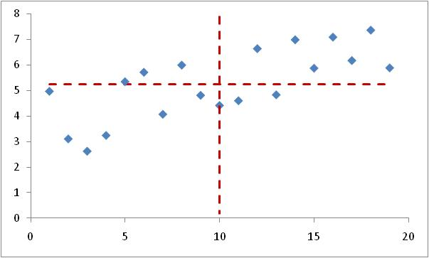
cov(x,y) = mean of products of each point desviation from mean values
Geometrical interpretation: mean of ‘signed’ areas from rectangles defined by points and the mean value lines

Slide 9
sign of covariance =
sign of correlation
Y
Y
Y
X
X
X
Positive correlation: cov > 0
Negative correlation: cov < 0
No correlation. cov ≈ 0

Slide 10
How to describe correlation (2):
Pearson correlation coefficient (r)
r is a kind of ‘normalised’ (dimensionless) covariance
r takes values form -1 (perfect negative correlation) to 1 (perfect positive correlation). r=0 means no correlation
Spearman correlation
Mannkendel correlation
(S = st dev of sample)

Slide 11
Pearson correlation coefficient (r)
Problems:
It is sensitive to outlayers
r is an estimate from the sample, but does it represent the population parameter?

Slide 12
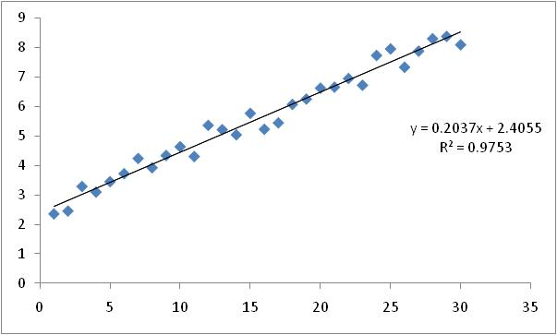
Linear regression:
- Regression: Prediction of one variable from knowledge of one or more other variables
How good is a linear model (y=ax+b) to explain the relationship of two variables?
If there is such a relationship, we can ‘predict’ the value y for a given x. But, which error could we be doing?
(25, 7.498)

Slide 13
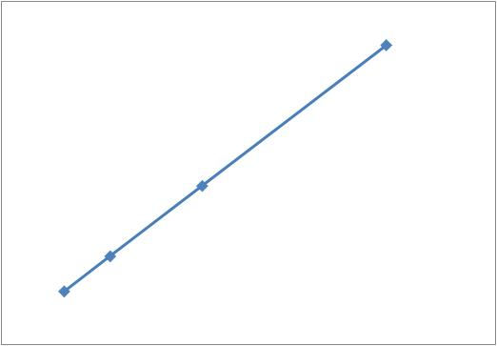
Preliminars:
Lineal dependence between 2 variables
Two variables are linearly dependent when the increase of one variable is proportional to the increase of the other one
Δy
Δx
Samples: - Energy needed to boil water
- Money needed to buy coffeepots

Slide 14
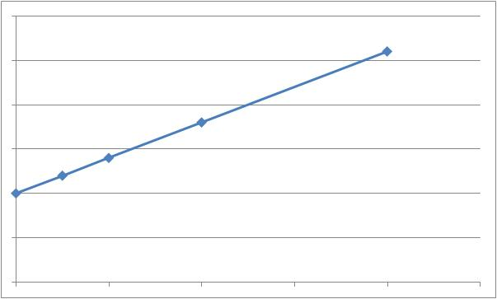
The equation y= mx+n that connects both variables has two parameters:
‘m’ is the unitary increase/decerease of y (how much increases or decreases y when x increases one unity)
‘n’ the value of y when x is zero (usually zero)
m
n
0
1
Samples: ‘m’= Energy needed to boil one liter of water , ‘n’=0
‘m’ = prize of one coffeepot, ‘n’= fixed tax/comission to add

Slide 15
Fiting data to a straight line (o viceversa):
Here, ŷ = ax + b
ŷ : predicted value of y
a: slope of regression line
b: intercept
ŷ = ax + b
ε _{i}
= ŷ_{i}, predicted
= y_{i} , observed
ε_{i} = residual
Residual error (ε_{i}): Difference between obtained and predicted values of y (i.e. y_{i}- ŷ_{i})
Best fit line (values of b and a) is the one that minimises the sum of squared errors (SS_{error}) Σ(y_{i}- ŷ_{i})²

Slide 16
Adjusting the straight line to data:
Minimise Σ(y_{i}- ŷ_{i})² , which is Σ(y_{i}-ax_{i}+b)²
Minimum SS_{error} is at the bottom of the curve where the gradient is zero – and this can found with calculus
Take partial derivatives of Σ(y_{i}-ax_{i}-b)² respect parametres a and b and solve for 0 as simultaneous equations, giving:
This calculus can allways be done, whatever is the data!!

Slide 17
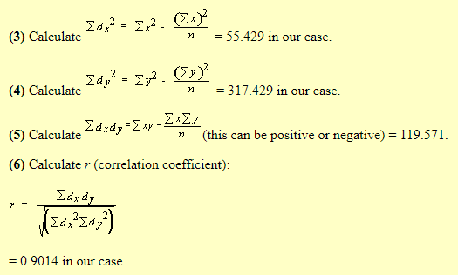
Correlation, and regression analysis for curve fitting
Mouse | Weight (x) | Length (y) | x² | y² | xy
Mouse 1 | 1 | 2 | 1 | 4 | 2
Mouse 2 | 4 | 5 | 16 | 25 | 20
Mouse 3 | 3 | 8 | 9 | 64 | 24
Mouse 4 | 4 | 12 | 16 | 144 | 48
Mouse 5 | 8 | 14 | 64 | 196 | 112
Mouse 6 | 9 | 19 | 81 | 361 | 152
Mouse 7 | 8 | 22 | 64 | 484 | 176
Total | Σ x = 37 | Σ y = 82 | Σ x² = 251 | Σ y² = 1278 | Σ xy = 553
Mean | = 5.286 | = 11.714
171
The regression equation for y on x is: y = bx + a where b is the slope and a is the intercept (the point where the line crosses the y axis)
We calculate b as:

Slide 18
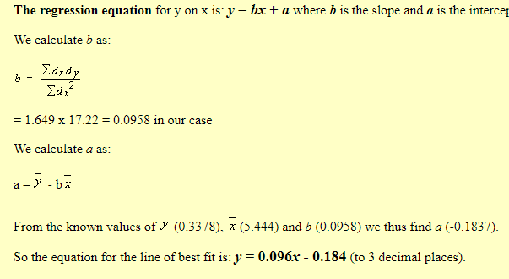

Slide 19
Project work:
Show the correlation
DBH cm | HT m
2 | 4
3 | 4.5
5 | 5.5
6 | 6.5
7 | 7.6
8 | 6.6
9 | 8.7
11 | 8.5
12 | 8.9
Find
R
a
B
Required equation

Slide 20
Is the model significant?
i.e. do we get a significantly better prediction of y from our regression equation than by just predicting the mean?
F-statistic:
complicated
rearranging
s_{ŷ}²
r² (n - 2)²
F
=
=......=
(df_{ŷ},df_{er})
s_{er}²
1 – r²
And it follows that:
r (n - 2)
So all we need to
know are r and n !
t_{(n-2)} =
√1 – r²

Slide 21
THANKS TOO MUCH

